Slide 1
EASY VISA

Slide 2
Table of content
Agenda
Data Description
Process followed in the project
Deduction from EDA process
Illustration of plots
Result table
Conclusion

Slide 3
Agenda:
To build the machine learning models in order to predict whether the. Facilitate the process of visa approvals. Recommend a suitable profile for the applicants for whom the visa should be certified or denied based on the drivers that significantly influence the case status.

Slide 4
Data Description
This dataset is taken from Github
Link : https://github.com/rochitasundar/Customer-profiling-using-ML-EasyVisa
The dataset contains 11 variables and 1 target
It contains 3 variable features and all are categorical
Data contains 25480 observations

Slide 5
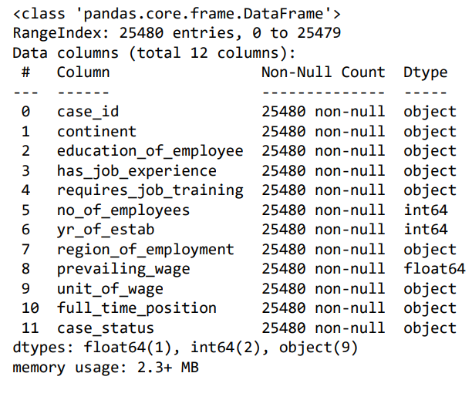
FEATURES

Slide 6
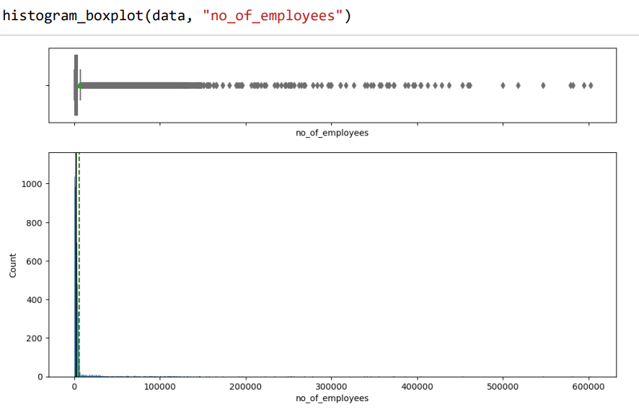
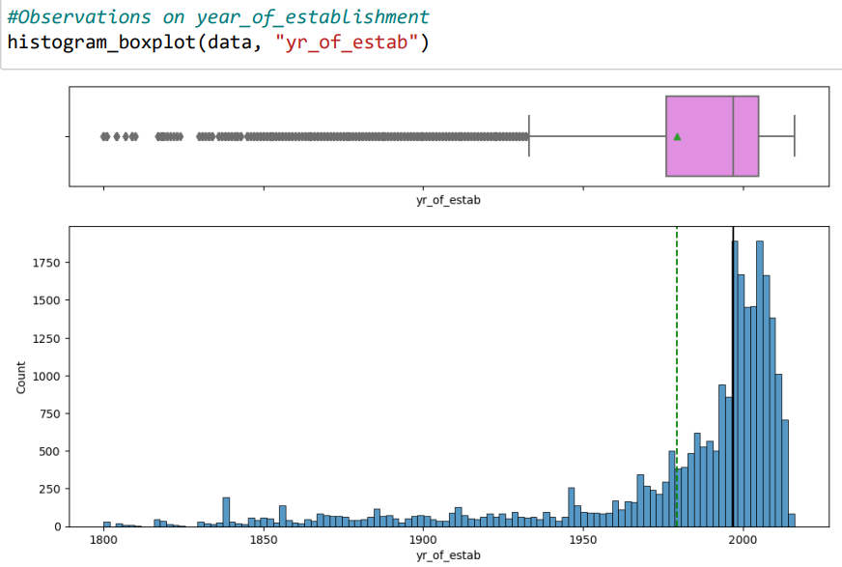
HISTOGRAM_BOXPLOT
The distribution for number of employees for
employers is heavily skewed right.
The distribution for year established is
skewed left.

Slide 7
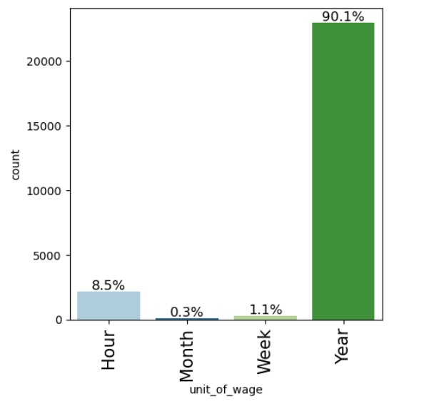
BAR PLOT
Almost 90% of all entries are with unit_of_wage as yearly and only 8.5% entries as hourly.
Negligible entries are on monthly and weekly basis.

Slide 8
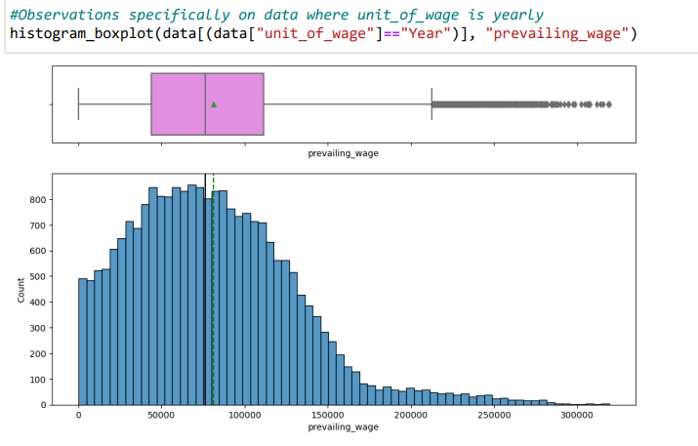
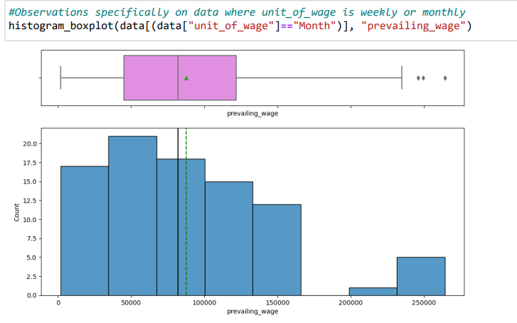
HSTOGRAM_BOXPLOT
The average and median annual salary is approx. USD 70,000 which seems accurate
The trend appears correct with outliers in the higher income bracket between USD 200,000 to USD 300,000
There are several very low salaries as well, which appears incorrect and requires further investigation

Slide 9
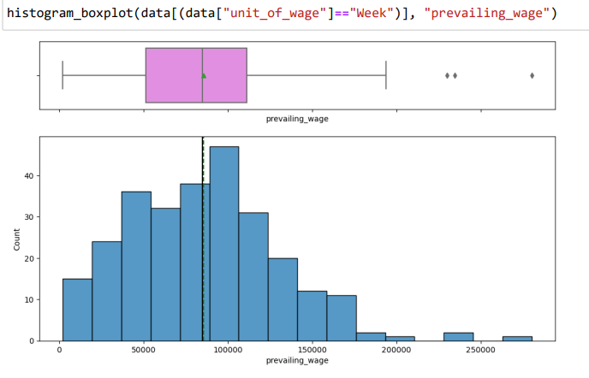
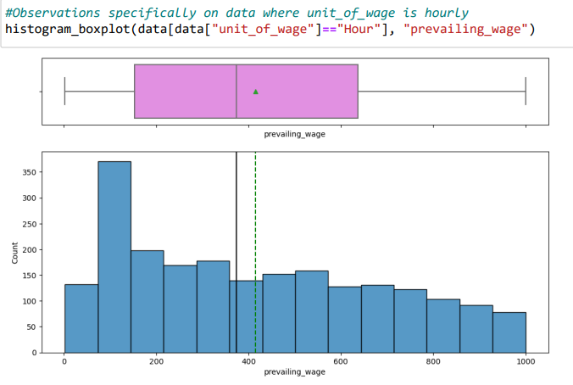
HISTOGRAM_BOXPLOT
Based on the data we see above, we can infer that the prevailing_wage is likely a weekly salary where unit_of_wage is hourly.
(We make this assumption as a median rate of pay of USD 400 per hour appears incorrect.)
Based on the data we see above, we can infer that prevailing_wages is likely already a yearly salary where unit_of_wage is either weekly or monthly

Slide 10
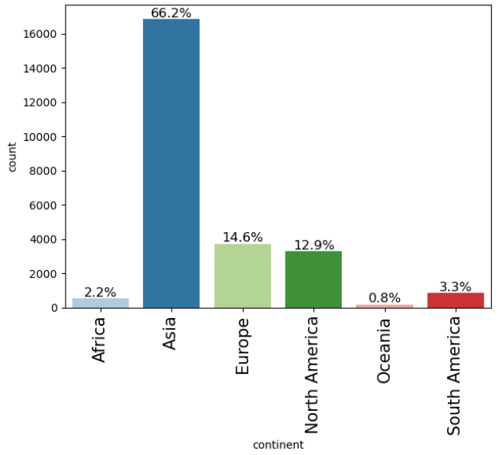
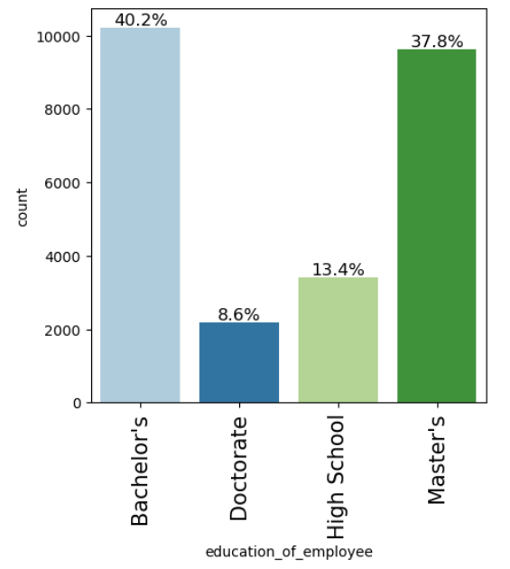
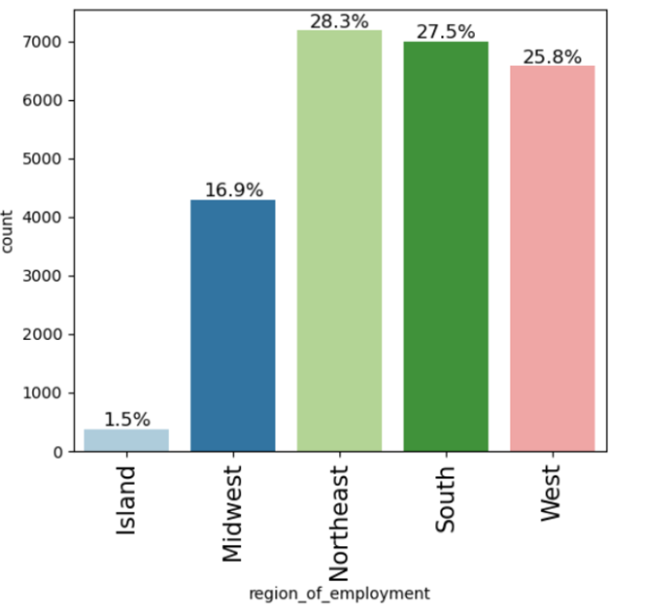
BARPLOT
Northeast, South and West equally have employment opportunities with Human Resource shortages with 25-28% employees applying for visa approval to these regions, followed by Midwest (18%) and Island (1.5%)
Majority of employees (>50%) are from Asia.
Majority of employees have either a bachelor's (40%) or a master's (38%) and minority of applicants have either a doctorate (8%) or only a high school diploma (13%)

Slide 11
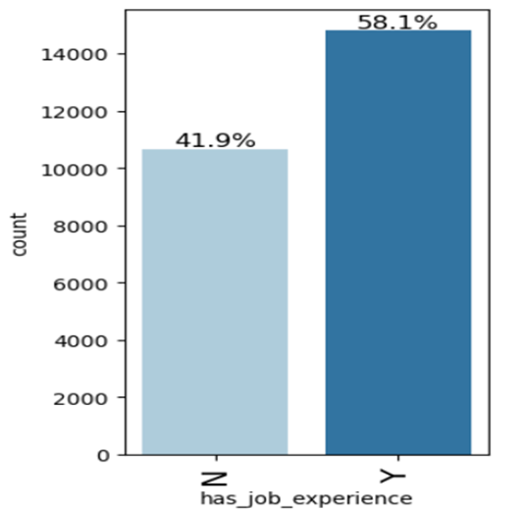
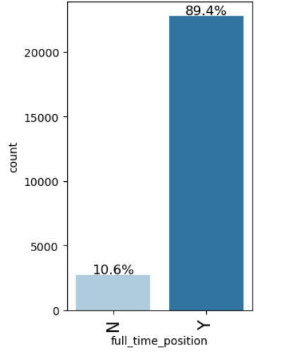
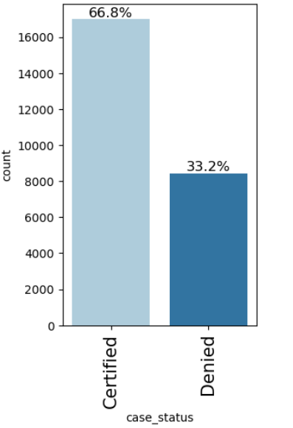
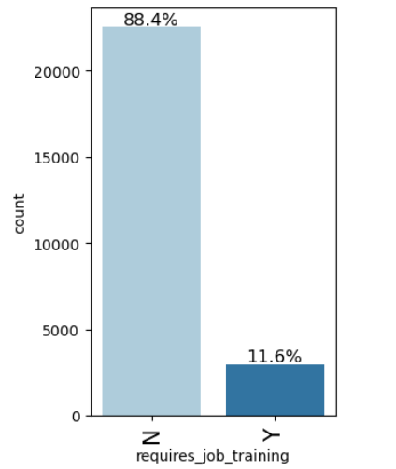
BARPLOT
Majority do not require job training (88%). Although we observed that only 58% had prior job experience. It is possible that some occupations require employees with no prior job experience
Approximately, 67% cases are approved and 33% cases are denied
Around 58% employees have prior job experience and 42% employees do not
88% are full time positions

Slide 12
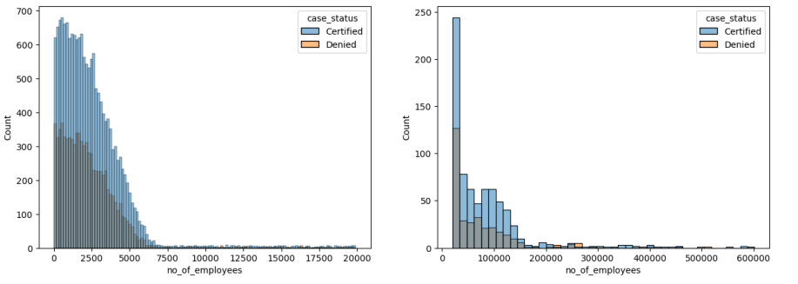
BIVARIATE ANALYSIS
Greater than twice the number of cases are certified than denied both for employers having lesser as well as more number of employees.
The large number of outliers in attribute will require further treatment. Although, the ML model is based on decision trees, which optimizes & splits(bins) the data by default, we can choose to bin the continuous datapoints into 3 practically chosen bins to decrease the model building time. This is because from the EDA, we see no spcific relationship between cases being certified and no_of_employees in an organization.

Slide 13
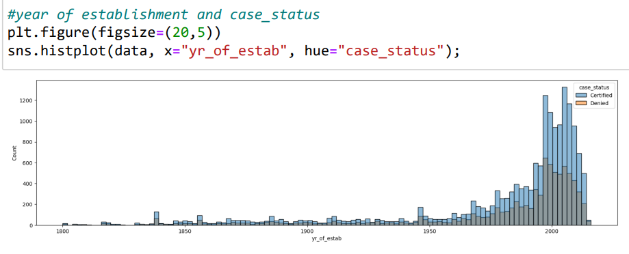
HISTPLOT
Similar to before, slightly more than 50% of all cases are certified than denied for employers irrespective of the employer's year of establishment
There are a large number of lower ended outliers, which will be binned likewise

Slide 14
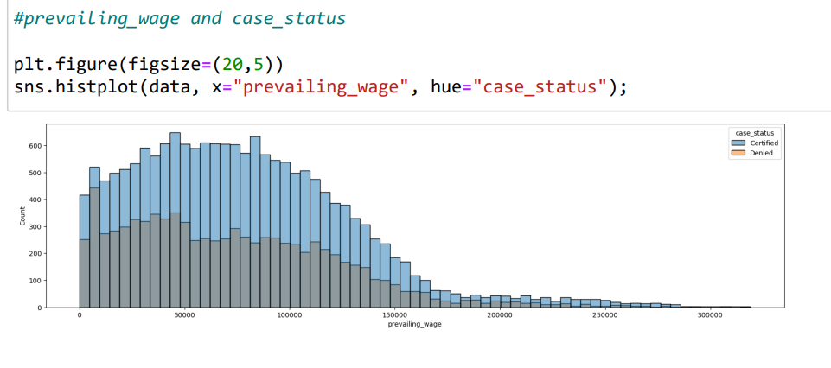
There are some outliers on the lower end (USD 14,500 or less annually) which are worrying. These may reference either positions that are unskilled or where tips received make up portion of the compensation. Similarly, there are outliers on the higher end (USD 200,000 or more annually) which reference highly skilled positions. We see a general trend that ~ twice the cases are certified more than denied.
% certifications in comparison to % denied drops slightly on the lower end of the prevailing_wage and increases slightly on the upper end of the prevailing_wage
The number of outliers are not as high as in the previous two instances (no_of_employees & yr_of_estab), as decision trees are immune to outliers, this has not been treated further. As well, above a certain income threshold & below a certain treshold, EDA indicates, similar response for case statuses

Slide 15
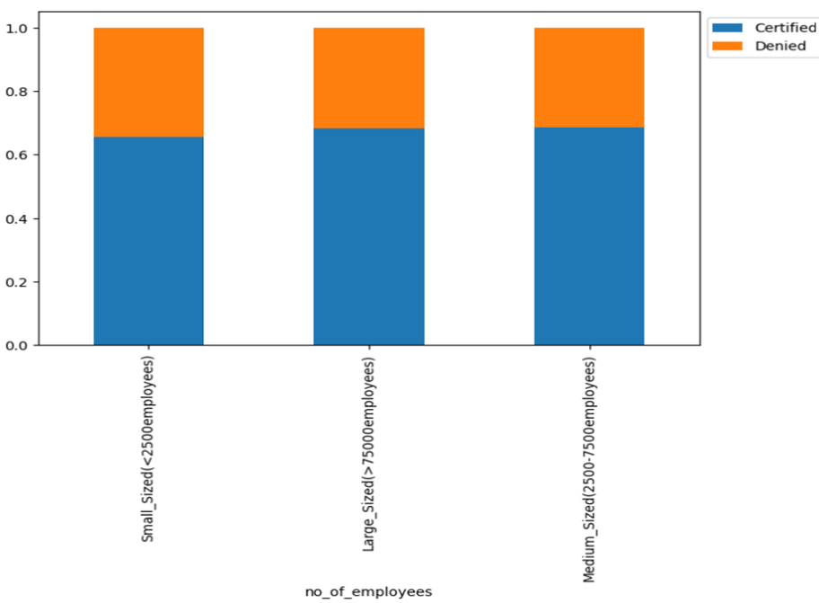
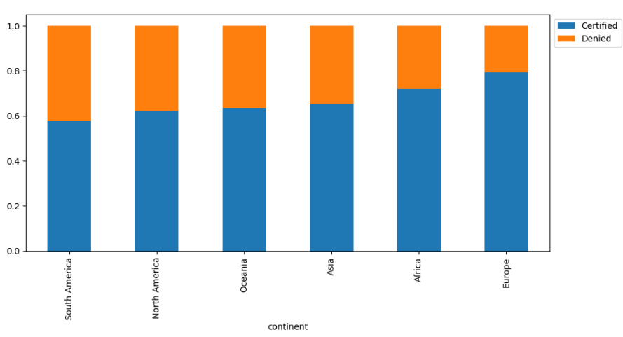
STACKED_BARPLOT
The information is retained after binning. >65% of cases in all categories are certified 58% are small sized companies (less than 2500 employees), 36% are medium_sized and 6% are larege sized companies (more than 7500 employees)
Irrespective of the continent the employee is from, more cases are certified than denied The trend observed w.r.t % certification for continents is Europe > Africa > Asia > Oceania > North America & South America

Slide 16
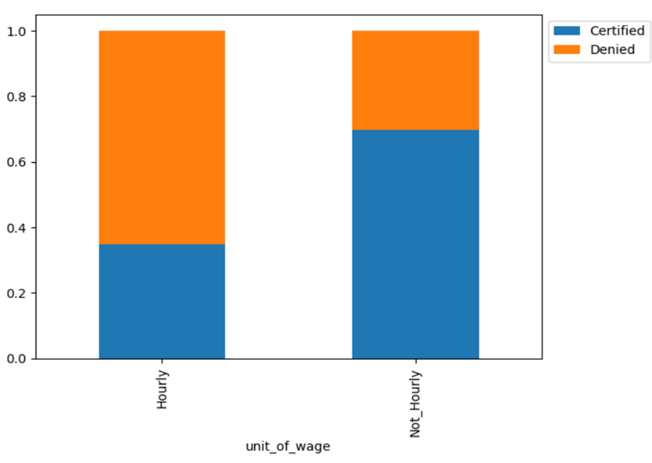
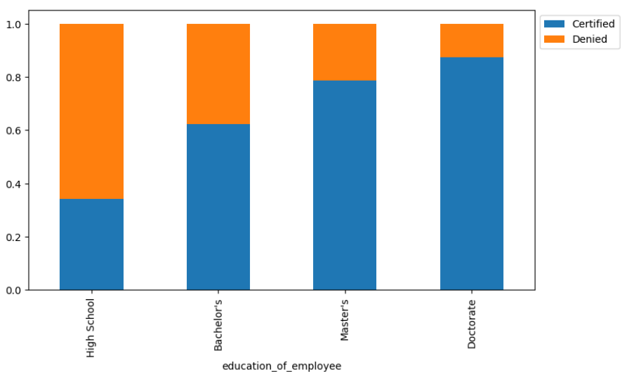
Almost 70% of cases are certified when the unit_of_wage is not hourly, and only 35% cases are certified when the unit_of_wage is hourly
As expected the, the trend observed w.r.t % visa certification for education of employees is Doctorate > Master's > Bachelor's > High School

Slide 17
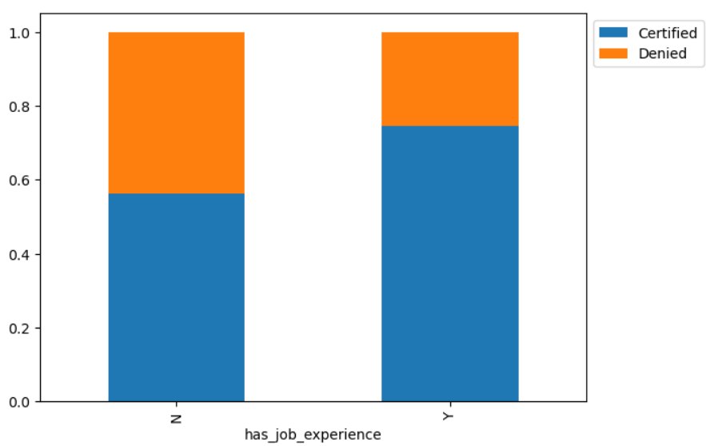
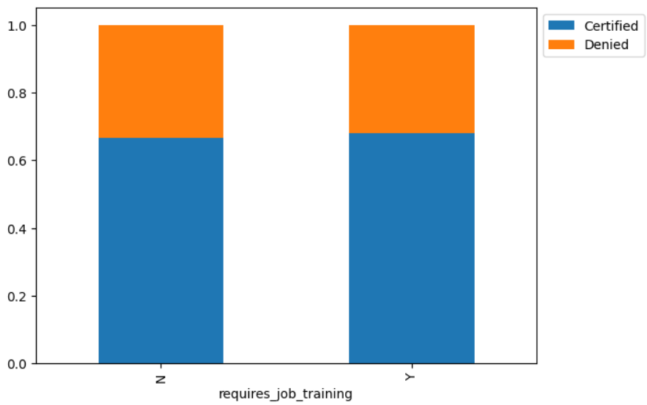
As expected, the trend observed w.r.t % visa certifications for has_job_experience is Yes > No
Trend observed w.r.t. % visa certifications for requires_job_training is same Yes ~ No

Slide 18
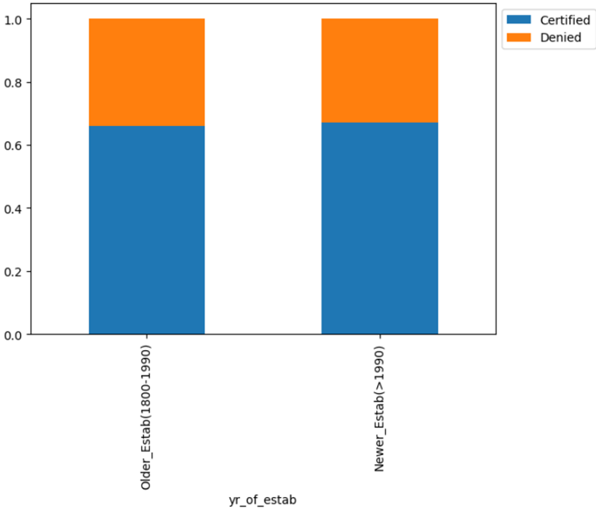
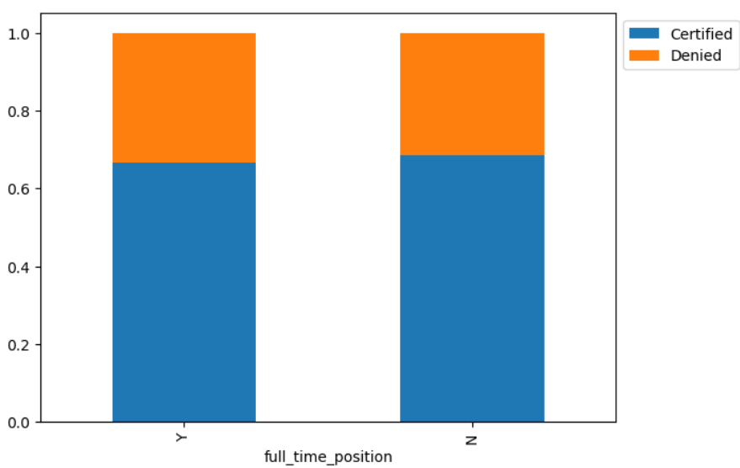
The information is retained after binning. >65% of cases in both categories are approved Around 61% of employers were established after 1990 and 39% of employers before 1990
Trend observed w.r.t. % visa certifications for full_time_position is same Yes ~ No

Slide 19
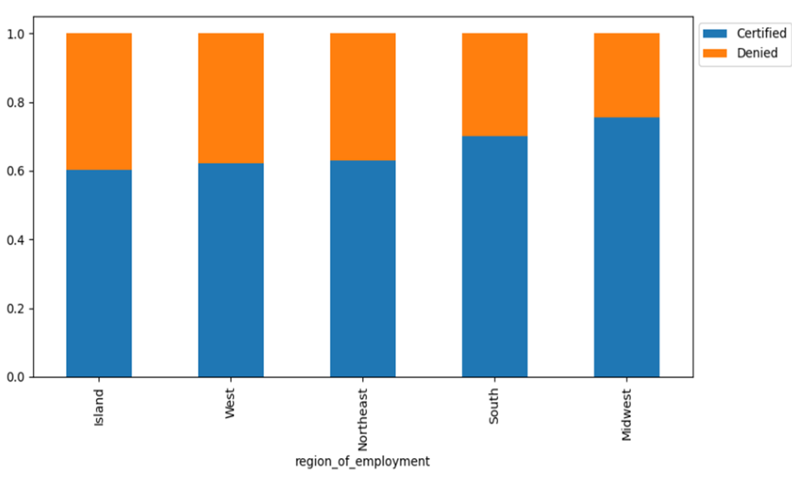
Trend observed w.r.t visa certifications for region_of_employment is MidWest > South > Northeast ~ West > Island

Slide 20
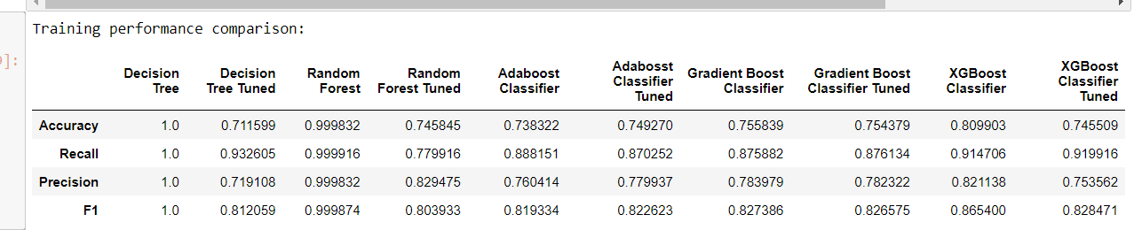
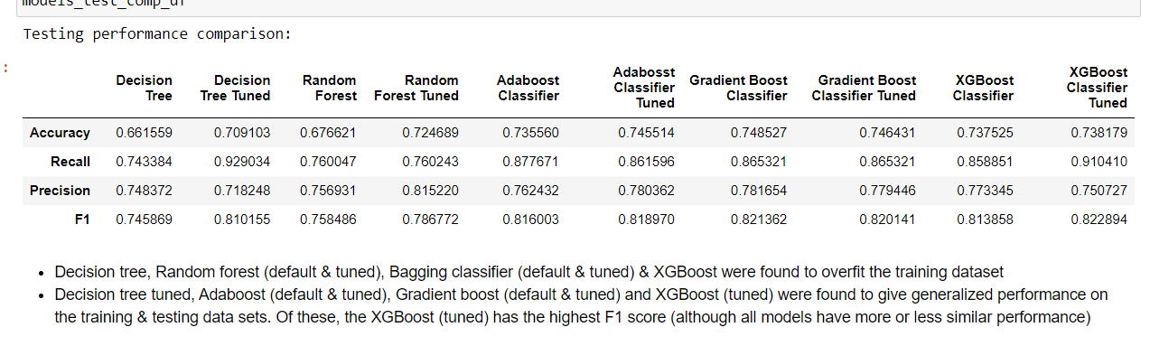
MODEL

Slide 21
CONCLUSION
Decision tree, Random forest (default & tuned), XGBoost were found to overfit the training dataset
Decision tree tuned, Adaboost (default & tuned), Gradient boost (default & tuned) and XGBoost (tuned) were found to give generalized performance on the training & testing data sets. Of these, the XGBoost (tuned) has the highest F1 score (although all models have more or less similar performance)

Slide 22
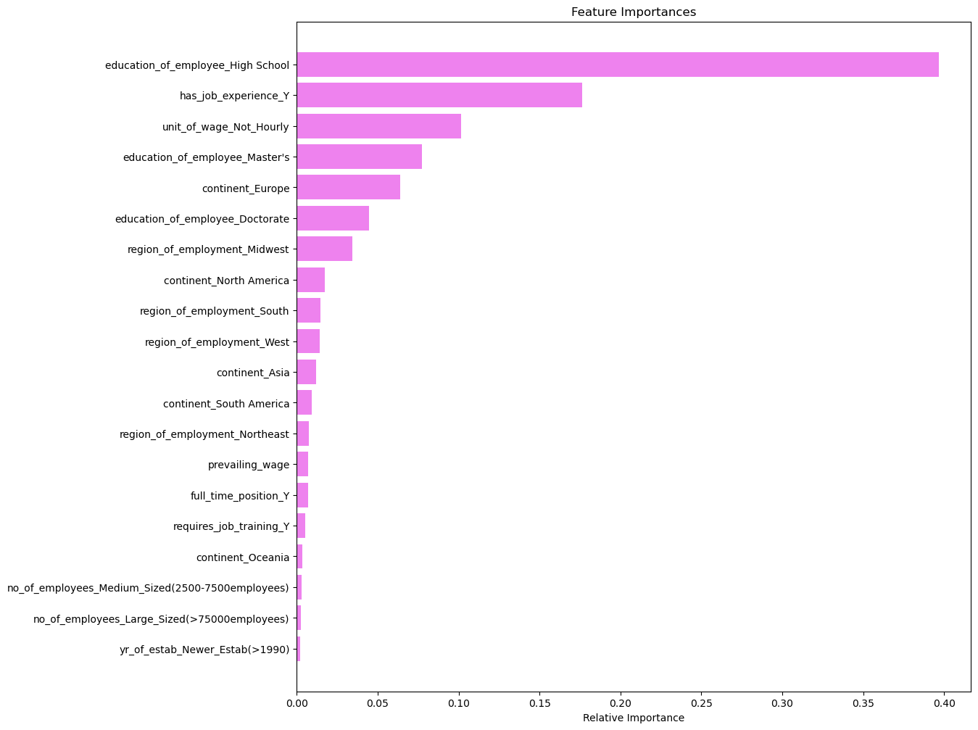
Feature importance of XGBoost Hyperparameter Tuned Model

